Slide 1
Prediction of Amazon Best Seller Book Prices 2010-2021

Slide 2
Model Motivation​
What factors can be used to​ predict price of a book in Amzon.com ?​

Slide 3
Feature Investigation​
Price
Rating
Customers rated
Year
Genre

Slide 4
Cleaning the data​
Duplicates​
NULL values​
Incorrect values​
Changed the format of the columns​

Slide 5
Feature Engineering​
Created dummy variables for the genre features ​
Drop for book title and author since they’re categorical and contain many values​
​

Slide 6
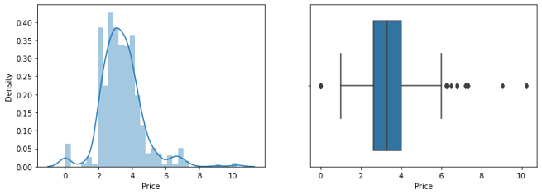
EDA
The data has some outliers, but they were kept as they had meaning.​

Slide 7
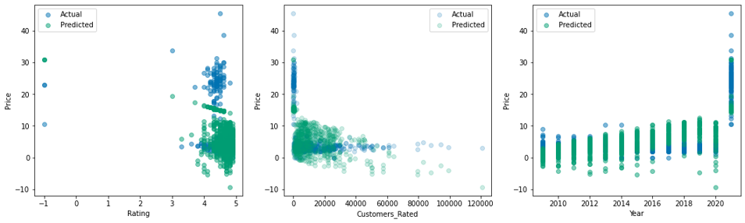
Feature Engineering​

Slide 8
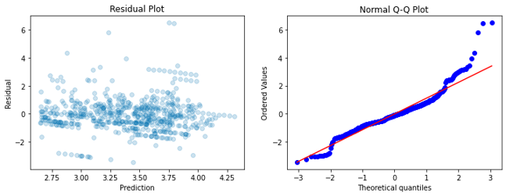
Baseline Model​
R² training set : 0.10031434506039706 ​
R² test set : 0.07665732576443074​
​

Slide 9
conclusion

Slide 10
Thank you for listening​
Prepared by:​
Afrah Almoutiri ​
Moneera Alfulaij​
Tamader AboAlhassan

